Slide 1
Applied Data Science Capstone
A brief idea of a renting system construction for workers (interns)
Changfa FU
17.02.2019

Slide 2
Introduction
As it becomes a trend to have an internship for college student in the United States. So let us assume that there are a group of students who wants to work in Washington DC and look for places to live. And they have requirements as following:
surrounded by restaurants
not far away from workplace
a balanced life with regards to work and relax
Therefore, where will be the best or preferred location for them to settle down?
It is where the challenge comes from!!!

Slide 3
Data
In order to find best place to locate for interns, we will need their company location (Foursquare API);
Meanwhile, Foursquare location data will be used to explore the surrounding area of the company with set radius;
After cluster the neighborhood and determine the region of settlement compared to DC address points seeking for availability
Foursquare API accessing
https://opendata.arcgis.com/datasets/aa514416aaf74fdc94748f1e56e7cc8a_0.csv?session=361463279.1550275769

Slide 4

Methodology
CRISP-DM – Cross Industry Standard Process for Data Mining
DISCRIPTIVE => EXPLORING
Locating
Exploring
Determining
Highly depends on the data from Foursquare API and D.C. Address Points

Slide 5

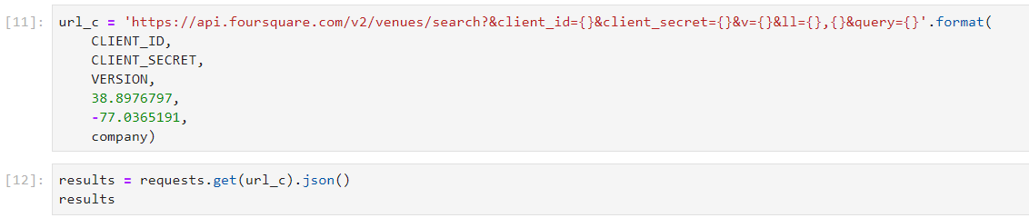
Locating

Slide 6
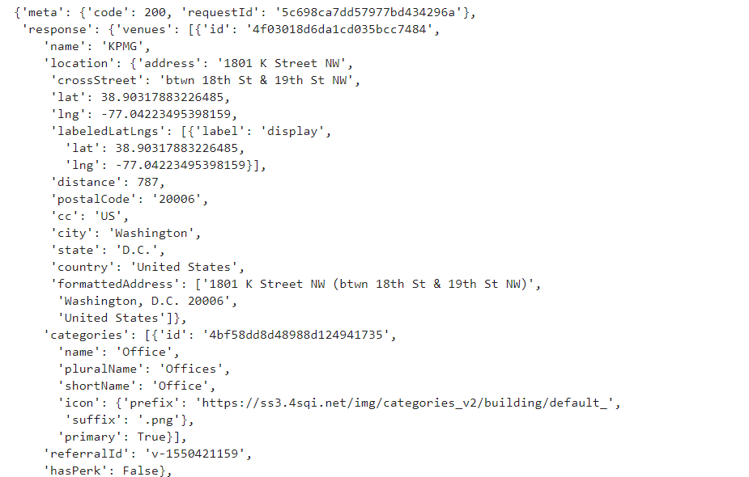
Results - Locating

Slide 7
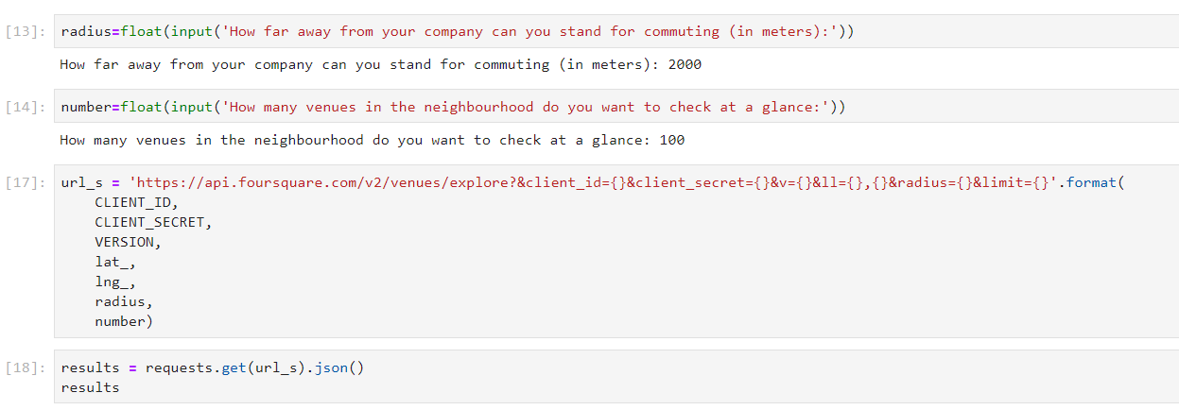
Exploring

Slide 8
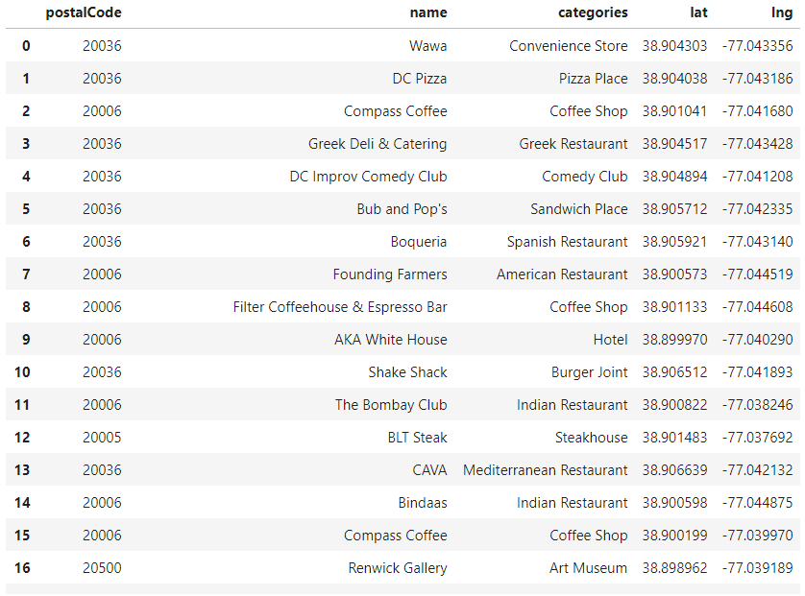
Results - Exploring

Slide 9
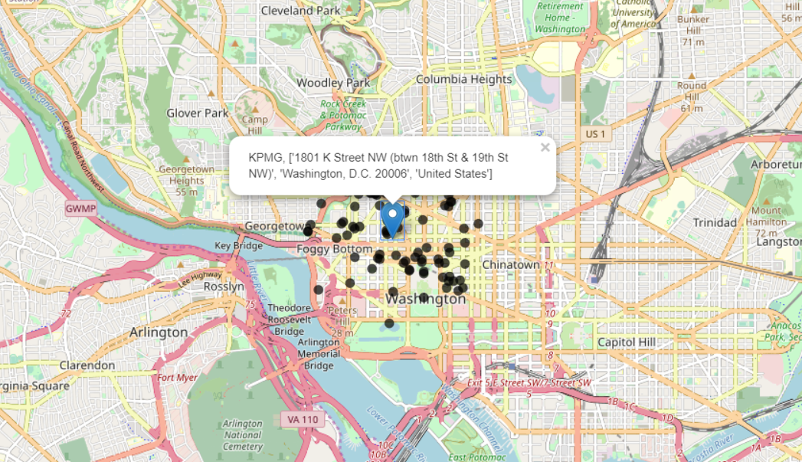
Results - Mapping

Slide 10
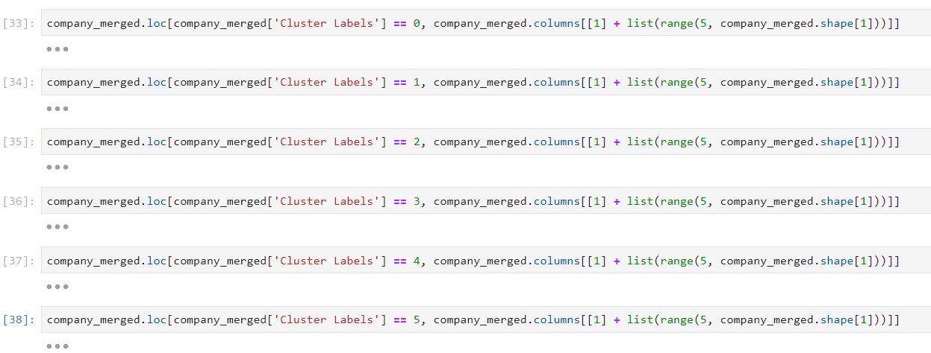
Clustering (into 6)

Slide 11
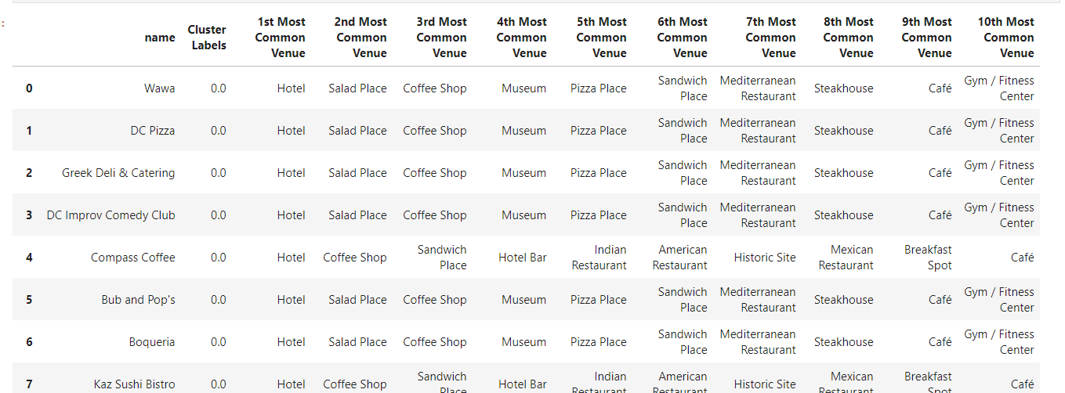

Results – Clustering 0

Slide 12
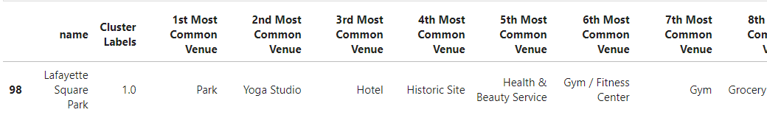
Results – Clustering 1

Slide 13
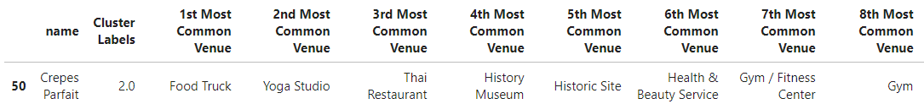
Results – Clustering 2

Slide 14
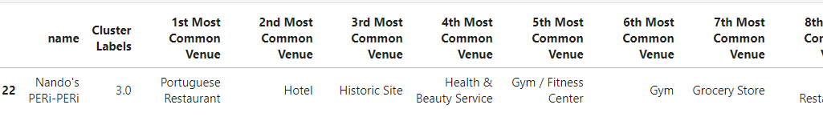
Results – Clustering 3

Slide 15
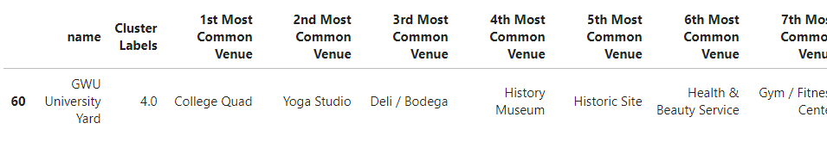
Results – Clustering 4

Slide 16
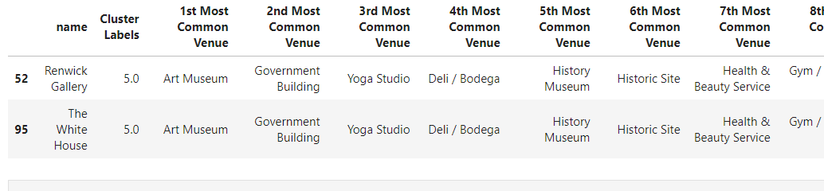
Results – Clustering 5

Slide 17
Discussion
Therefore, where should the student locate to meeting requirements above?
Recap of requirements:
surrounded by restaurants
The majority are concentrated in cluster 0,
not far away from workplace
In the radius of 1000 m centered at the company
a balanced life with regards to work and relax
Depending on venues nearby
Cluster 0 gets the most
THUS, it is quite evidnet that cluster 0 will be the best area for the student to settle in
Refer back to common postal code in cluster 0
With help of dataset of D.C. Address Points, we can have recommendations for the student to find a preferred house

Slide 18
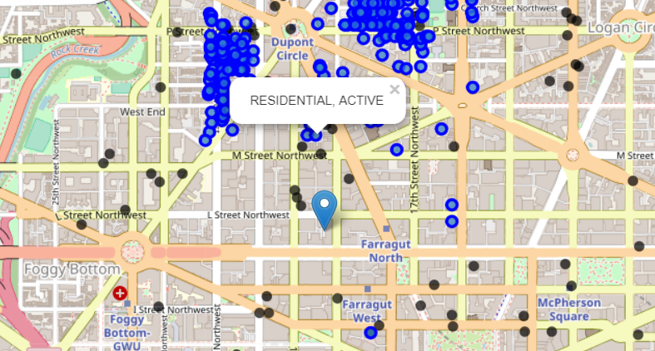
Conclusion
Location Icon stands for the company
Blue points are active housing options
Black points are TOP 100 venues surrounded

